Slide 1
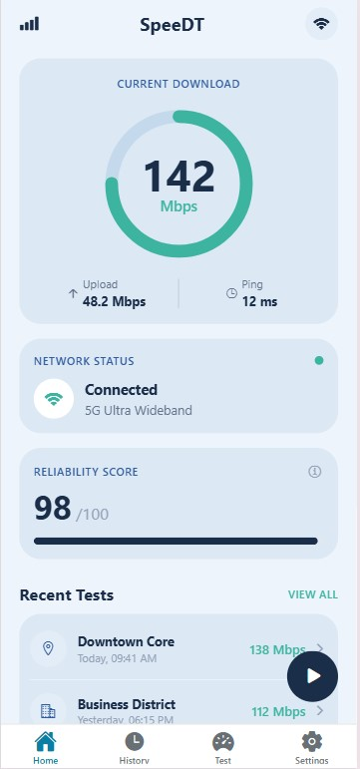
SpeeDT
CEF440 – GROUP4
Task 5: UI Design and Implementation
GROUP 4 MEMBERS
Instructor: Dr. Engr. Nkemeni Valery

Slide 2
Table of contents
01
INTRODUCTION
04
Frontend Implementatio
02
App identity
05
Technical Deep Dive
03
Visual Design Figma
06
Conclusion
Project content & objectives
Expo, React Native, MVVM architecture
Branding, naming & target users
TypeScript models, routing, styling
Summary & next steps
Wireframes, palette & screen mockups

Slide 3
Introduction
What is SpeeDT?
Network Challenge
in Cameroon
🎯
A QoE Mobile Network Monitoring App for Cameroon monitoring MTN, Orange & CAMTEL networks on Android & iOS.
54%
46%
Built on Previous Tasks
🔗
Extends requirements analysis (Task 2–3) and system design (Task 4) into a working mobile frontend.
Android share
iOS share
Core Tools Used
🛠️
3
1
Figma for UI/UX prototyping. React Native + Expo + TypeScript for cross-platform implementation.
Major carriers
Regulator (ART)
Architecture
🏗️
MVVM pattern ensures clean separation of data, UI, and logic layers for maintainability and scalability.

Slide 4
App Identity
Regular users
Technical Users
Researchers & ART
SpeeDT = Speed + Data + Telecom · Privacy-first · Cross-platform · Cameroon-focused
Students, traders, professionals who want simple network quality checks and notifications.
Networking students & engineers who need signal strength, latency, and generation data.
Regulators & researchers analyzing crowdsourced coverage data while respecting user privacy.

Slide 5

Designed for Every User
A Design for Visibility
The design system employs a clean, high-contrast aesthetic using pure black text on crisp white surfaces. This ensures maximum readability in bright outdoor environments common in the Cameroonian context.
Typography: System Sans-Serif (Inter/Roboto) ensures native device rendering speeds and modern clean aesthetics.

Slide 6
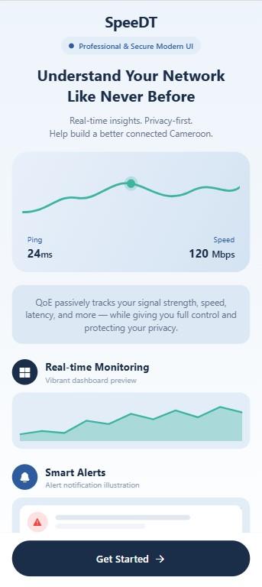
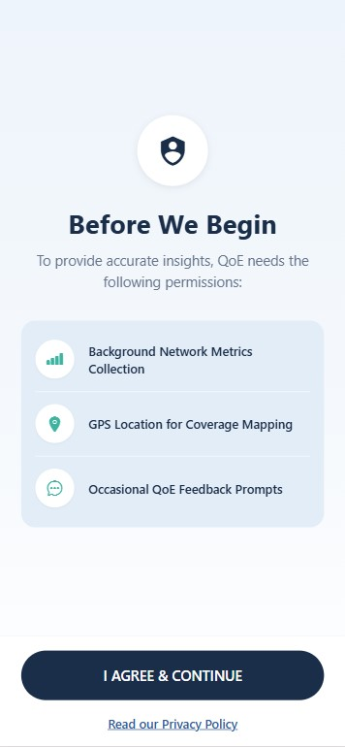
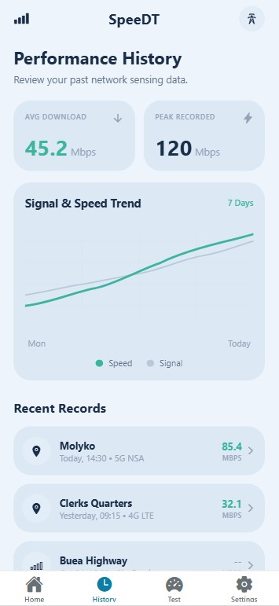
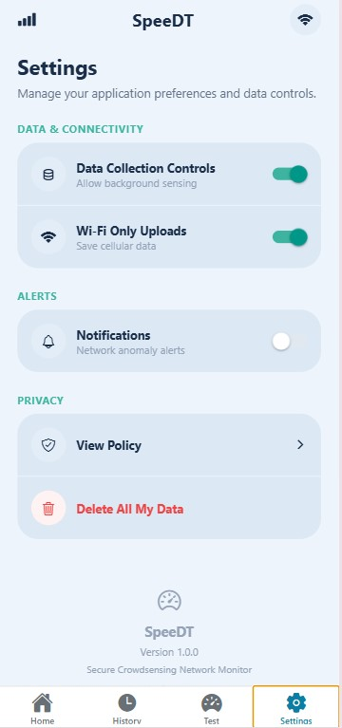
03.
Visual Design - Figma
COLOUR PALETTE & DESIGN SYSTEM
#1A2E4A
#2E5B9E
#3CB4A0
#DCE8F4
#EEF4FB
Brand Navy
Brand Blue
Brand Teal
Card Surface
Screen BG
KEY SCREENS FIGMA WIREFRAMES
[ Screenshot
Placeholder ]
[ Screenshot
Placeholder ]
[ Screenshot
Placeholder ]
[ Screenshot
Placeholder ]
[ Screenshot
Placeholder ]
Onboarding
& Welcome
Consent &
Permissions
Home
Dashboard
History &
Trends
Settings &
Privacy

Slide 7
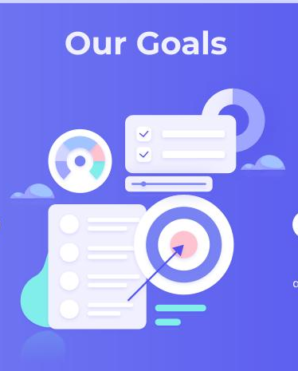
]
Onboarding
& Welcome
Consent &
Permissions
Home
Dashboard
History &
Trends
Settings &
Privacy

Slide 8
Screen Mockups: Deep Dive
Onboarding
Screen 1
App name + tagline · 3 feature preview blocks · Get Started → Consent
Consent & Permissions
Screen 2
Shield header · 3 permission toggles · ART-compliant privacy gate
Home Dashboard
Screen 3
SVG circular speed gauge · Reliability Score bar · Live network status dot
Performance History
Screen 4
7-day trend chart (SVG) · Avg + peak speed stats · No-service event flags
Settings & Privacy
Screen 5
Data collection toggles · Wi-Fi only upload option · Destructive purge action

Slide 9
Frontend Implementation
File-Based Routing
Fast Refresh
Cross-Platforms
Native modules
Expo is to React Native what Next.js is to React — same power, far less configuration
⚡
Instant visual feedback via Expo Go over local Wi-Fi. No rebuild cycle.
Expo Router: creating app/(tabs)/home.tsx auto-registers the /home route.
Single codebase for Android (54%) + iOS (46%) in Cameroon's market.
Camera, haptics, splash screen, linear gradient — zero native code edits.

Slide 10
Project Architecture - MVVM
MVVM PATTERN
FILE STRUCTURE
SpeedDT/
MODEL
Network data storage & management (NetworkMetric interface)
├── app/
│ ├── (tabs)/home.tsx
│ ├── (tabs)/history.tsx
│ ├── (tabs)/test.tsx
VIEWMODEL
Processes data · useNetworkState hook · React Context consent layer
│ └── consent.tsx
├── screens/
│ ├── home-screen.tsx
Home · History · Test · Settings screen components
│ └── test-screen.tsx …
VIEW
├── components/
├── navigation/routes.ts
└── constants/theme.ts
app/ = thin route wrappers only · screens/ = all UI logic · Decoupled routing from implementation

Slide 11
Technical Deep Dive
FULL TECHNOLOGY STACK
TYPESCRIPT DATA MODEL
Expo SDK ~54
Build toolchain + native modules
id
string
Unique probe GUID
React Native 0.81
Core mobile UI framework
timestamp
string
ISO 8601 datetime
carrierName
enum
MTN | Orange | CAMTEL
TypeScript ~5.9
Full type safety across codebase
networkGeneration
enum
2G | 3G | 4G | 5G
Expo Router ~6
File-based typed navigation
rsrp / rssi / sinr
number | null
Nullable on iOS
NativeWind 4 + Tailwind 3
Utility CSS → React Native styles
latencyPingMs
number
Round-trip time (ms)
react-native-svg 15
SVG gauges & trend charts
packetLossPercentage
number
0%–100% loss
expo-linear-gradient
Onboarding gradient background
districtLocation
string | null
District-level only

Slide 12
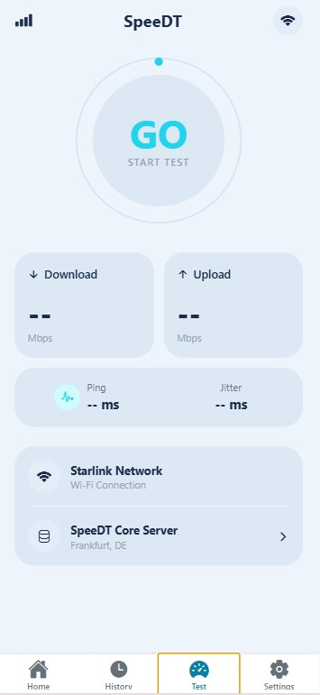
Routing, Styling & Performance
NAVIGATION ROUTES
NATIVEWIND STYLING SYSTEM
/
→ OnboardingScreen
React Native has no CSS.
NativeWind compiles Tailwind classes into RN StyleSheet at build time:
className="flex-1 bg-brand-card
rounded-3xl text-brand-navy"
/consent
→ ConsentScreen
/(tabs)/home
→ HomeScreen
/(tabs)/history
→ HistoryScreen
PERFORMANCE OPTIMISATIONS (SRS non-functional requirements)
< 3%
< 5MB
2s
/(tabs)/test
→ TestScreen
Battery / hour
Data / day
UI refresh cycle
/(tabs)/settings
→ SettingsScreen
In-memory cache for dashboard · Deferred chart processing · useSafeAreaInsets on all screens

Slide 13
Screen Showcase
Key UI components per implemented screen
Home Dashboard
Speed Test Screen
History Screen
› SVG circular download gauge (strokeDashoffset)
› GO button: 208×208 SVG ring
› SVG bezier trend chart (speed + signal)
› Upload / Ping metric row
› 3-state flow: idle → testing → complete
› Mon–Today x-axis labels + legend
› Network Status card with live dot
› useState<TestStatus> + useRef timeout
› Avg download + peak stat cards
› Reliability Score progress bar
› Download, Upload, Ping, Jitter cards
› No-service event flagging

Slide 14
Development Challenges
Screen Size Diversity
Technical vs Simple Ux
Challenge: Consistent layout across devices with different screen ratios and notch types
Solution: useSafeAreaInsets hook + Flexbox auto-scaling via NativeWind utility classes.
Challenge: Balancing rich network metrics (RSRP, SINR, jitter) with a clean interface for non-technical users.
Solution: Progressive disclosure: summary on Home, details in History, raw data in Settings.

Slide 15

Conclusion
🎨
📱
1
6
Figma Design System
6 screens prototyped
Implemented Screens
Full navigation flow
🏗️
MVVM
Architecture
Model · View · ViewModel

Slide 16
Thank You
SpeeDT — QoE Mobile Network Monitoring Application
CEF440: Internet and Mobile Programming · Group 4 · University of Buea, 2025
GROUP 4
Ako Junior Ngoh
Etuma Elkings Bosango
Moukam Hako Bellamy Steve
Njikang Bright Ndode Ngone
Ringnyu Mbunwe Giyoh Lemuel

